Slide 1
Modes of Operation
Lecture slides are adopted frok“Cryptography and Network Security” by W. Stallings
Notes:
Lecture slides by Lawrie Brown for “Cryptography and Network Security”, 4/e, by William Stallings, Chapter 6 “Contemporary Symmetric Ciphers”.

Slide 2
Content
Shortfalls of using plain cipher
What is padding & modes of operation
Different modes of operation
ECB
CBC
CFB
OFB
CTR

Slide 3
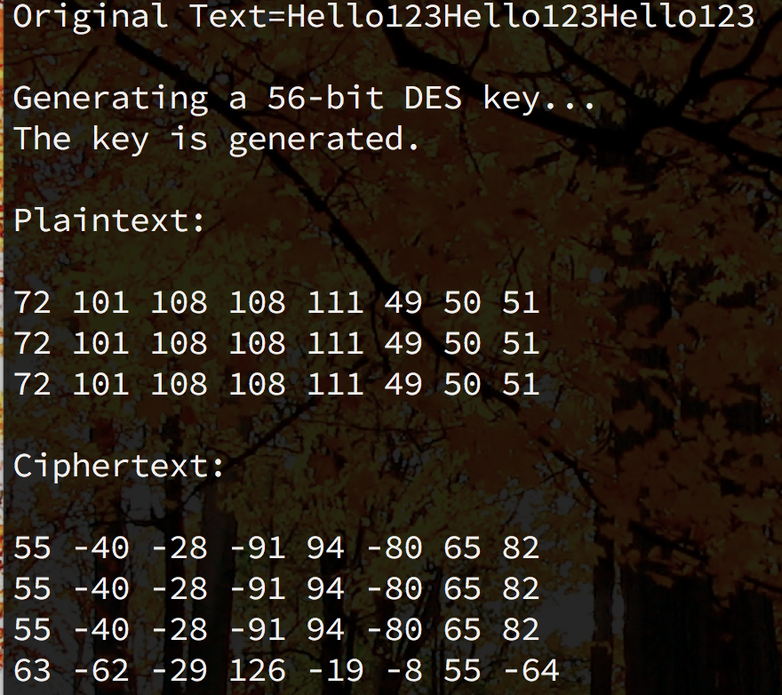
Problem
Ciphers are deterministic
Same message + same key = same ciphertext

Slide 4
Modes of Operation
Block ciphers (always a basic building block that en/decrypts a fixed size block of data) encrypt fixed size blocks. ie.
DES encrypts 64-bit blocks with 56-bit key
AES encrypts 128-bit blocks with 128/192/256-bit key
Modes of operation
used to handle arbitrary amounts of data in practise to improve security
It describes how repeatedly to apply a cipher’s single-block operation securely to transform amounts of data larger than a block
5 modes defined for AES & DES
Applicable for block and stream modes
Notes:
DES (or any block cipher) forms a basic building block, which en/decrypts a fixed sized block of data.
However to use these in practise, we usually need to handle arbitrary amounts of data, which may be available in advance (in which case a block mode is appropriate), and may only be available a bit/byte at a time (in which case a stream mode is used).
To apply a block cipher in a variety of applications, four “modes of operation” have been defined by NIST (FIPS 81). The four modes are intended to cover virtually all the possible applications of encryption for which a block cipher could be used. As new applications and requirements have appeared, NIST has expanded the list of recommended modes to five in Special Publication 800-38A. These modes are intended for use with any symmetric block cipher, including triple DES and AES.

Slide 5
Message Padding
One issue that arises with block cipher is how to handle the last block
Block size ➔ Fixed. i.e DES 64 bits and AES 128 bits
Message size (input) ➔ Not fixed
A possible implementation
Pad with extra bits at the last block as follows:
Pad with known non-data value (eg nulls)
Pad with bits + count of pad size
E.g. [ b1 b2 b3 0 0 0 0 5]
3 data bytes, then 5 bytes pad + count
Example of a padding scheme PKCS5
Overheads
Need to recognise padding at the receiving end
Must know the count of padding
Notes:
Both ECB and CBC padding may be used
AES/CBC/NoPadding (128)
AES/CBC/PKCS5Padding (128)
https://docs.oracle.com/javase/7/docs/api/javax/crypto/Cipher.html
One issue that arises with block modes is how to handle the last block, which may well not be complete. In general have to pad this block (typically with 0's), and then must recognise padding at other end - may be obvious (eg in text the 0 value should usually not occur), or otherwise must explicitly have the last byte as a count of how much padding was used (including the count). Note that if this is done, if the last block IS an even multiple of 8 bytes or has exactly the same form as pad+count, then will have to add an extra block, all padding so as to have a count in the last byte. There are other, more esoteric, “ciphertext stealing” modes, which avoid the need for an extra block.

Slide 6
Block Cipher Modes of Operation

Slide 7
Electronic Code Book (ECB)
Simplest mode of operation
Message split into independent blocks
Each block is encrypted independently with the same key.
Each block is substituted with another value → like a codebook (hence named ECB)
C_{i} = En_{K}(P_{i})
C = ciphertext, P = Plaintext , K = Key
Use In: secure transmission of single block of info needs to be sent
i.e Session key encrypted using a master key
Notes:
The simplest mode is the electronic codebook (ECB) mode, in which plaintext is handled one block at a time and each block of plaintext is encrypted using the same key. ECB is the simplest of the modes, and is used when only a single block of info needs to be sent (eg. a session key encrypted using a master key).

Slide 8
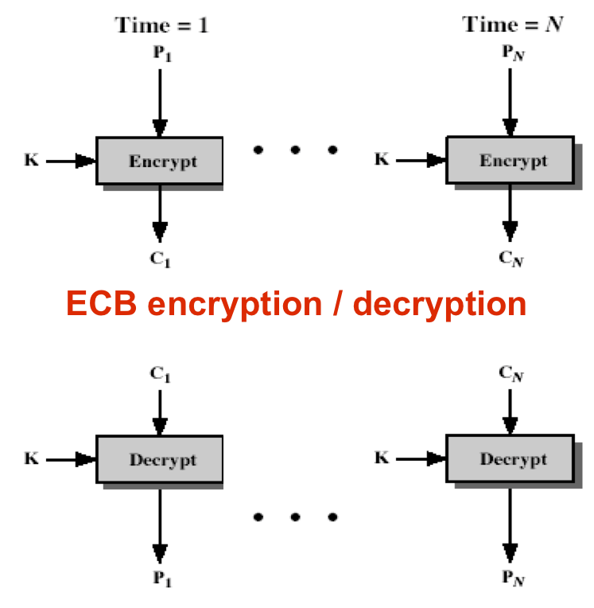
Electronic Code Book (ECB) (Cont)
Notes:
Stallings Figure 6.3 illustrates the Electronic Codebook (ECB) Mode.

Slide 9
ECB : Limitations
Deterministic : not appropriate of any quantity of data
Data block 1..n using the same key, encrypted twice will get the same ciphertext with same plain text.
When messages known to have subtle changes only (but send repeatedly) can be used for analysis.
Message repetitions show in ciphertext
Obvious in certain type of data (e.g. graphics)
weakness is due to the encrypted message blocks being independent
Limitations: For sending a few blocks of data
Notes:
ECB is not appropriate for any quantity of data, since repetitions can be seen, esp. with graphics

Slide 10
Cipher Block Chaining (CBC)
Message split into blocks
Cipher blocks are linked together
Each previous cipher blocks is chained with current plaintext block, hence called cipher block chaining
Initialization Vector (IV) is used to start the process
IV : Most modes require a unique binary sequence, known as IV, for each encryption operation. IV is usually random or non-repeating
IV ensures the different ciphertext blocks will be generated, even though the same plaintext blocks appeared multiple times in the message
C₀ = IV
C_{i} = En_{K}(P_{i} XOR C_{i-1})
Use In: bulk data encryption, authentication
Notes:
To overcome the problems of repetitions and order independence in ECB, want some way of making the ciphertext dependent on all blocks before it. This is what CBC gives us, by combining the previous ciphertext block with the current message block before encrypting. To start the process, use an Initial Value (IV), which is usually well known (often all 0's), or otherwise is sent, ECB encrypted, just before starting CBC use. CBC mode is applicable whenever large amounts of data need to be sent securely, provided that all data is available in advance (eg email, FTP, web etc).

Slide 11
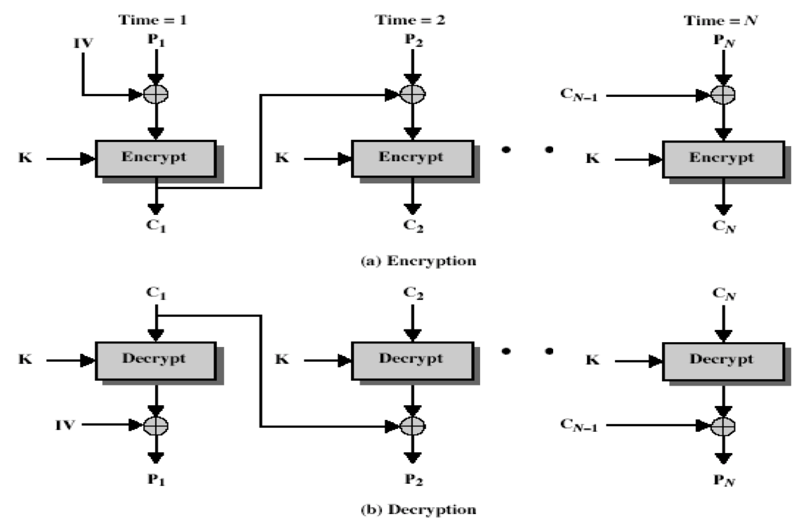
Cipher Block Chaining (CBC) (Cont)
Notes:
Stallings Figure 6.4 illustrates the Cipher Block Chaining (CBC) Mode.
Compare ECB & CBC encryption of image. http://www.crypto-it.net/eng/theory/modes_of_block_ciphers.html

Slide 12
CBC : Features
A ciphertext block depends on all blocks before it (not just the key)
Any change to a block affects all following ciphertext blocks
The chaining provides an avalanche effect
Common Initialization Vector (IV) between sender & receiver
IV need not be secret as the purpose of IV is to ensure same plaintexts encrypt to different ciphertexts
IV need to be random so that is unlikely for the IV to coincide with the first plaintext block by accident
IV need to be random to avoid attackers to base on known IV value to check/verify of their guesses (brute force attack)
IV could be sent encrypted as the 1st block (effectively ECB mode) before the rest of message
Notes:
Why IV need NOT be secret please read → https://defuse.ca/cbcmodeiv.htm
Better options for IV protection
Padding Oracle attack – A external entity that will offer extra info of the cipher text (the oracle will have known the IV , secret key and encryption algorithm)
See the attack scenrio section in - http://resources.infosecinstitute.com/padding-oracle-attack-2/#
CBC is the block mode generally used. The chaining provides an avalanche effect, which means the encrypted message cannot be changed or rearranged without totally destroying the subsequent data. However there is the issue of ensuring that the IV is either fixed or sent encrypted in ECB mode to stop attacks on the 1st block.

Slide 13
Stream Ciphers
Process message bit-by-bit (as a stream)
Uses a pseudo random keystream
Deterministic yet would pass randomness tests
Combined (XOR) with plaintext bit-by-bit
Randomness of stream key completely destroys statistically properties in message
C_{i} = M_{i} XOR StreamKey_{i}
Never reuse stream key → Otherwise can recover messages
Common stream ciphers : RC4, Salsa20
Notes:
A typical stream cipher encrypts plaintext one byte (or bit) at a time, usually by XOR’ing with a pseudo-random keystream. The stream cipher is similar to the one-time pad discussed in Chapter 2. The difference is that a one-time pad uses a genuine random number stream, whereas a stream cipher uses a pseudorandom number stream. But rely on the randomness of stream key completely destroys statistically properties in message. However, you must never reuse a stream key since otherwise you can recover messages (as with a book cipher).

Slide 14
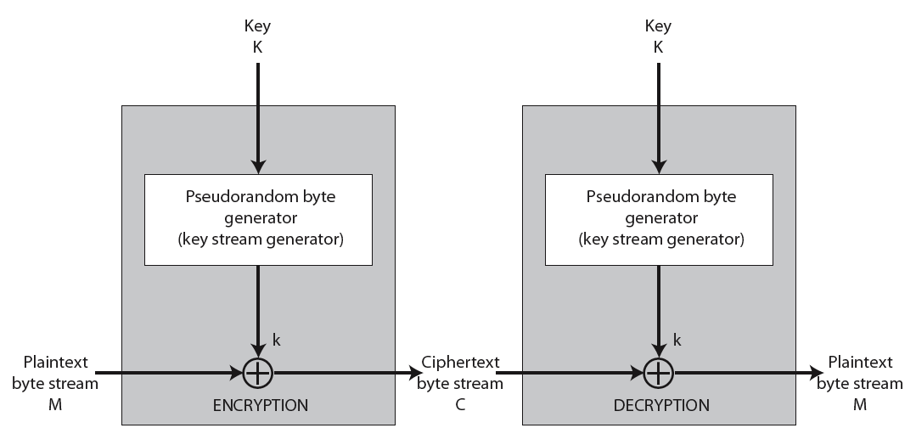
Stream Cipher Structure
Notes:
Stallings Figure 6.8 illustrates the general structure of a stream cipher, where a key is input to a pseudorandom bit generator that produces an apparently random keystream of bits, and which are XOR’d with message to encrypt it, and XOR’d again to decrypt it by the receiver.

Slide 15
Stream Cipher Properties
Design considerations are:
No repetitions over long period
statistically random
depends on large enough key (avoid brute force attack)
As secure as a block cipher (with same size key) if properly designed
Usually simpler (use less codes) & faster
Notes:
[KUMA97] lists the following important design considerations for a stream cipher:
The encryption sequence should have a large period, the longer the period of repeat the more difficult it will be to do cryptanalysis.
The keystream should approximate the properties of a true random number stream as close as possible, the more random-appearing the keystream is, the more randomized the ciphertext is, making cryptanalysis more difficult.
To guard against brute-force attacks, the key needs to be sufficiently long. The same considerations as apply for block ciphers are valid here .Thus, with current technology, a key length of at least 128 bits is desirable.
With a properly designed pseudorandom number generator, a stream cipher can be as secure as block cipher of comparable key length. The primary advantage of a stream cipher is that stream ciphers are almost always faster and use far less code than do block ciphers.

Slide 16
Cipher FeedBack (CFB) Mode
Message stream (in bits) added to the output of the block cipher
Each ciphertext block get ‘feedback’ into the encryption process in order to encrypt the next plaintext block
Allows any number of bit (1,8,64 or 128 etc) to be feedbacked
denoted CFB-1, CFB-8 (8 bits), CFB-64 (64 bits), CFB-128 (128 bits) etc
Most efficient when all bits in block (64 or 128) are used
C_{i} = P_{i} XOR En_{K}(C_{i-1})
C₀ = IV
Use In : stream data encryption, authentication
Notes:
If the data is only available a bit/byte at a time (eg. terminal session, sensor value etc), then must use some other approach to encrypting it, so as not to delay the info.
Idea here is to use the block cipher essentially as a pseudo-random number generator (see stream cipher lecture later) and to combine these "random" bits with the message.
Note as mentioned before, XOR is an easily inverted operator (just XOR with same thing again to undo). Again start with an IV to get things going, then use the ciphertext as the next input. As originally defined, idea was to "consume" as much of the "random" output as needed for each message unit (bit/byte) before "bumping" bits out of the buffer and re-encrypting.
This is wasteful though, and slows the encryption down as more encryptions are needed. An alternate way to think of it is to generate a block of "random" bits, consume them as message bits/bytes arrive, and when they're used up, only then feed a full block of ciphertext back. This is CFB-64 or CFB-128 mode (depending on the block size of the cipher used eg DES or AES respectively). CFB is the usual choice for quantities of stream oriented data, and for authentication use.

Slide 17
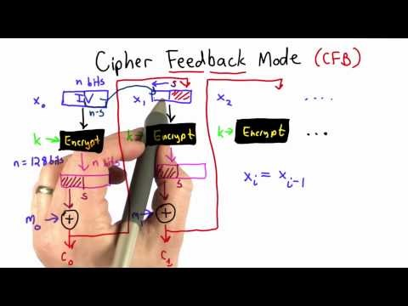
Cipher FeedBack (CFB) Mode (Cont)

Slide 18
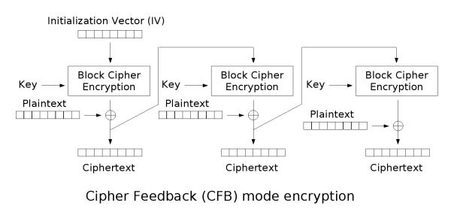
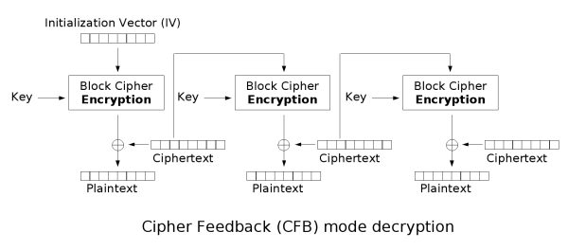
Cipher FeedBack (CFB) Mode (Cont)
Notes:
Stallings Figure 6.5 illustrates the Cipher FeedBack (CFB) Mode.

Slide 19
CFB: Advantages & Limitations (Cont)
Most appropriate when data arrives in bits/bytes (stream mode). i.e every 8 bytes
Limitations :
Will stall during block encryption after every n-bits if can’t keep up with input data
Block cipher is used in encryption mode at both ends
Errors propagate for several blocks
If network transmitting data is “noisy”.
Notes:
CFB is the usual stream mode. As long as can keep up with the input, doing encryptions every 8 bytes. A possible problem is that if its used over a "noisy" link, then any corrupted bit will destroy values in the current and next blocks (since the current block feeds as input to create the random bits for the next). So either must use over a reliable network transport layer (pretty usual) or use OFB.

Slide 20
Output FeedBack (OFB)
Use unique IV to generate a sequence of output blocks that are XOR with the plaintext
Output of cipher is added to message stream
Output is then feedback to the next cycle independent of message
Can be computed in advance
C_{i} = P_{i} XOR O_{i}
O_{i} = En_{K}(O_{i-1})
O₀ = IV
Use In: stream encryption on noisy channels
Notes:
The alternative to CFB is OFB. Here the generation of the "random" bits is independent of the message being encrypted. The advantage is that firstly, they can be computed in advance, good for bursty traffic, and secondly, any bit error only affects a single bit. Thus this is good for noisy links (eg satellite TV transmissions etc).

Slide 21
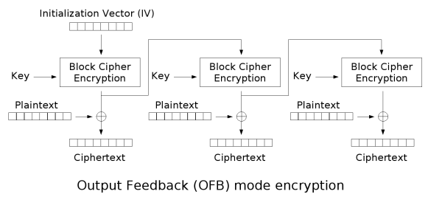
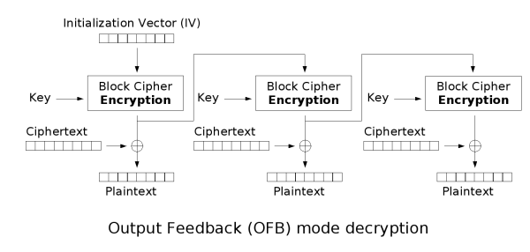
Output FeedBack (OFB) (Cont)
Notes:
Stallings Figure 6.6 illustrates the Output FeedBack (OFB) Mode.

Slide 22
OFB: Advantages & Limitations (Cont)
Bit errors do not propagate
Single bit error in ciphertext C₁ only affect one bit in plaintext P₁. As such, easy for recovery.
Must never reuse the same key+IV
If reuse, portion of output stream can be recovered
Based on research, it is more optimum to use Full block feedback (ie OFB-64 or OFB-128)
Notes:
One advantage of the OFB method is that bit errors in transmission do not propagate. The disadvantage of OFB is that it is more vulnerable to a message stream modification attack than is CFB.
Since OFB is a Vernam cipher variant, the stream should never be used more than once (otherwise the 2 ciphertexts can be combined, cancelling these bits, and leaving a "book" cipher to solve). And sender & receiver need to remain in sync, or all data is lost. Also, research has shown that you should only ever use a full block feedback ie OFB-64/128 mode.

Slide 23
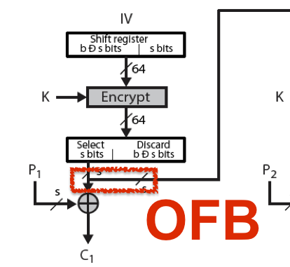
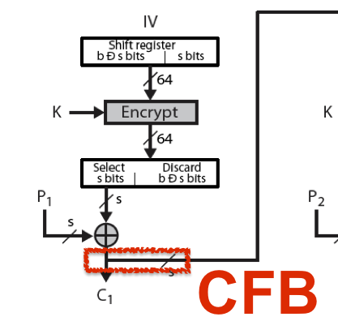
OFB vs CFB
Notes:
Stallings Figure 6.6 illustrates the Output FeedBack (OFB) Mode.

Slide 24
Counter (CTR)
Similar to OFB but encrypts counter value rather than any feedback value (hence named)
A “new” mode
Required a different key or a different counter value for every plaintext block (never reused)
C_{i} = P_{i} XOR O_{i}
O_{i} = En_{K}(i)
Application: high-speed network such as ATM (asynchronous transfer mode) encryptions
Notes:
The Counter (CTR) mode is a variant of OFB, but which encrypts a counter value (hence name). Although it was proposed many years before, it has only recently been standardized for use with AES along with the other existing 4 modes. It is being used with applications in ATM (asynchronous transfer mode) network security and IPSec (IP security). A counter, equal to the plaintext block size is used. The only requirement stated in SP 800-38A is that the counter value must be different for each plaintext block that is encrypted. Typically the counter is
ialized to some value and then incremented by 1 for each subsequent block.

Slide 25
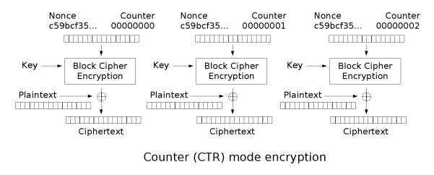
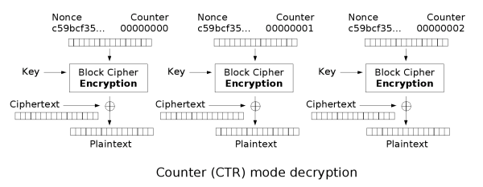
Counter (CTR) (Cont)
Notes:
Stallings Figure 6.7 illustrates the Counter (CTR) Mode.

Slide 26
CTR: Advantages & Limitations
Efficiency
can do parallel encryptions
block cipher operations can preprocess in advance
good for bursty high speed links
Provable security (good as other modes)
Breakable if reuse key/counter values (similar to OFB)
Notes:
CTR mode has a number of advantages in parallel h/w & s/w efficiency, can preprocess the output values in advance of needing to encrypt, can get random access to encrypted data blocks, and is simple. But like OFB have issue of not reusing the same key+counter value.

Slide 27
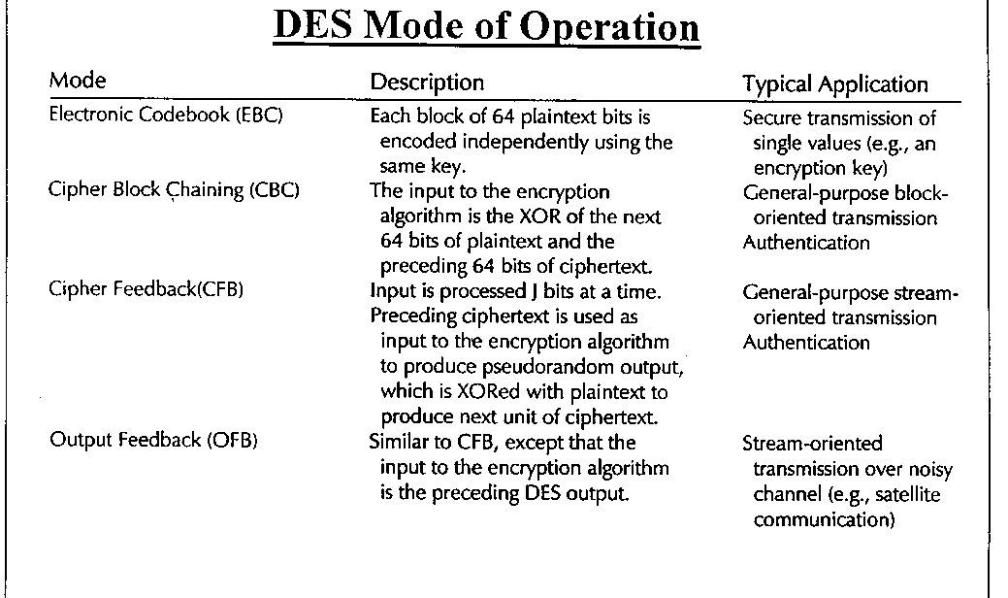

Slide 28
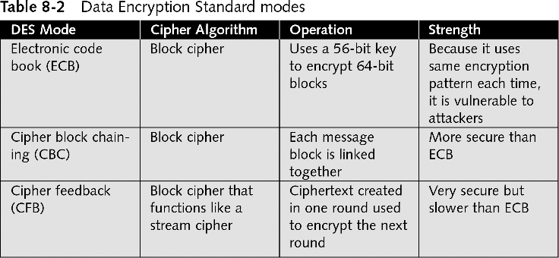
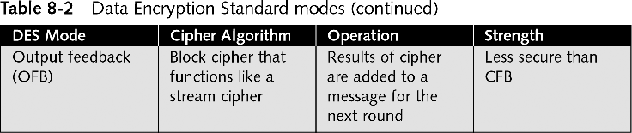

Slide 29
Summary
Modes of operation, IV and padding are used to secure the message
Same plain text → Different cipher text
Message length modified after encryption
Modes of operation for Block and Stream ciphers
ECB, CBC, CFB, OFB, CTR
Notes:
Chapter 6 summary.

